Slide 1
Important Note:
This is a very abbreviated version of the narrated PowerPoint presentation. It is not designed to replace the narrated PowerPoint presentation.
It has the key concepts and ideas you should learn, and might serve as a useful study guide.

Slide 2
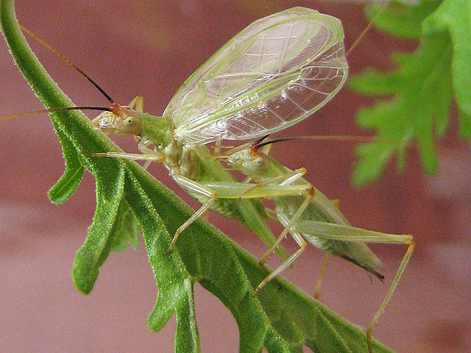
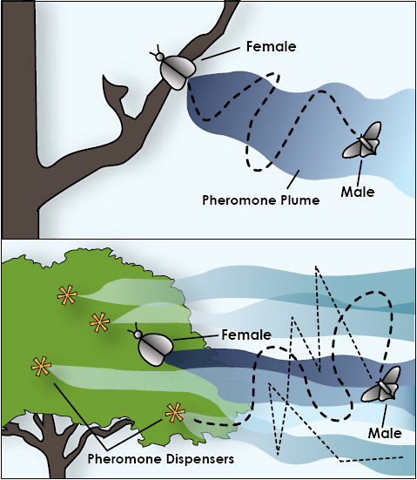
Communication
Objectives:
1. How do insects communicate with
each other?
2. Examples used to get the sexes together
Greg Zolnerowich
gregz@ksu.edu

Slide 3
Insect Communication: Finding a mate
Mate-finding requires communication -- the exchange of information between 2 (or more) organisms
signal
sender
channel
receiver
noise
Different species use different modes of communication:
1. visual 4. vibratory
2. chemical/olfactory 5. combination
3. sound/auditory

Slide 4
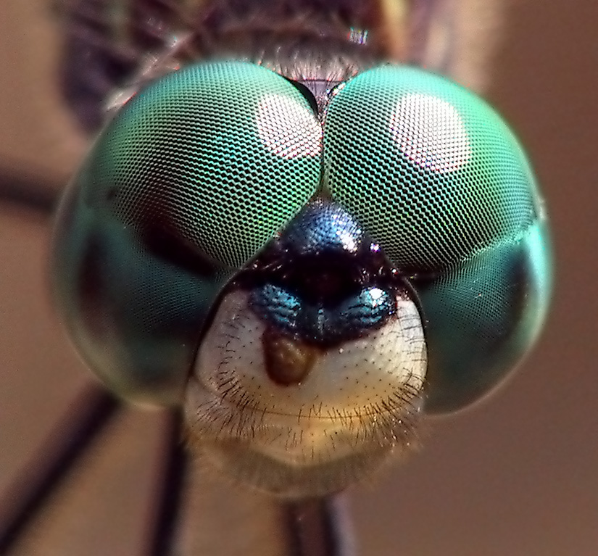
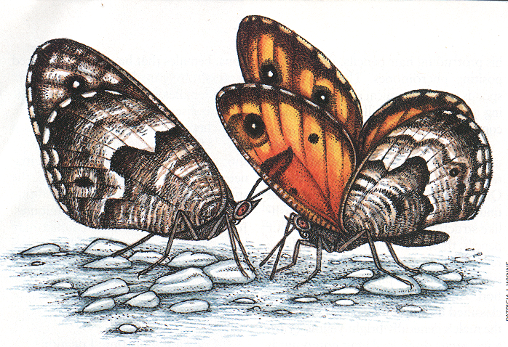
Visual Communication
species-specific marks

Slide 5
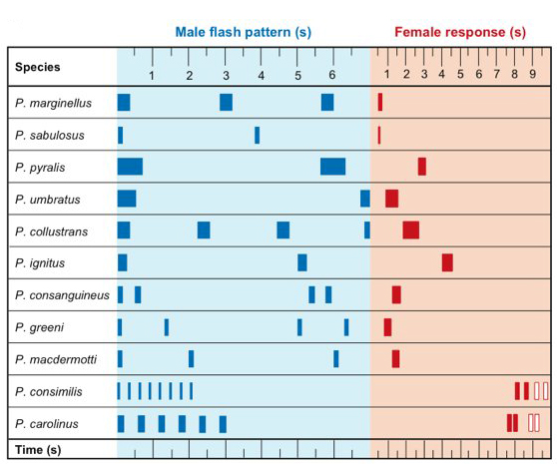
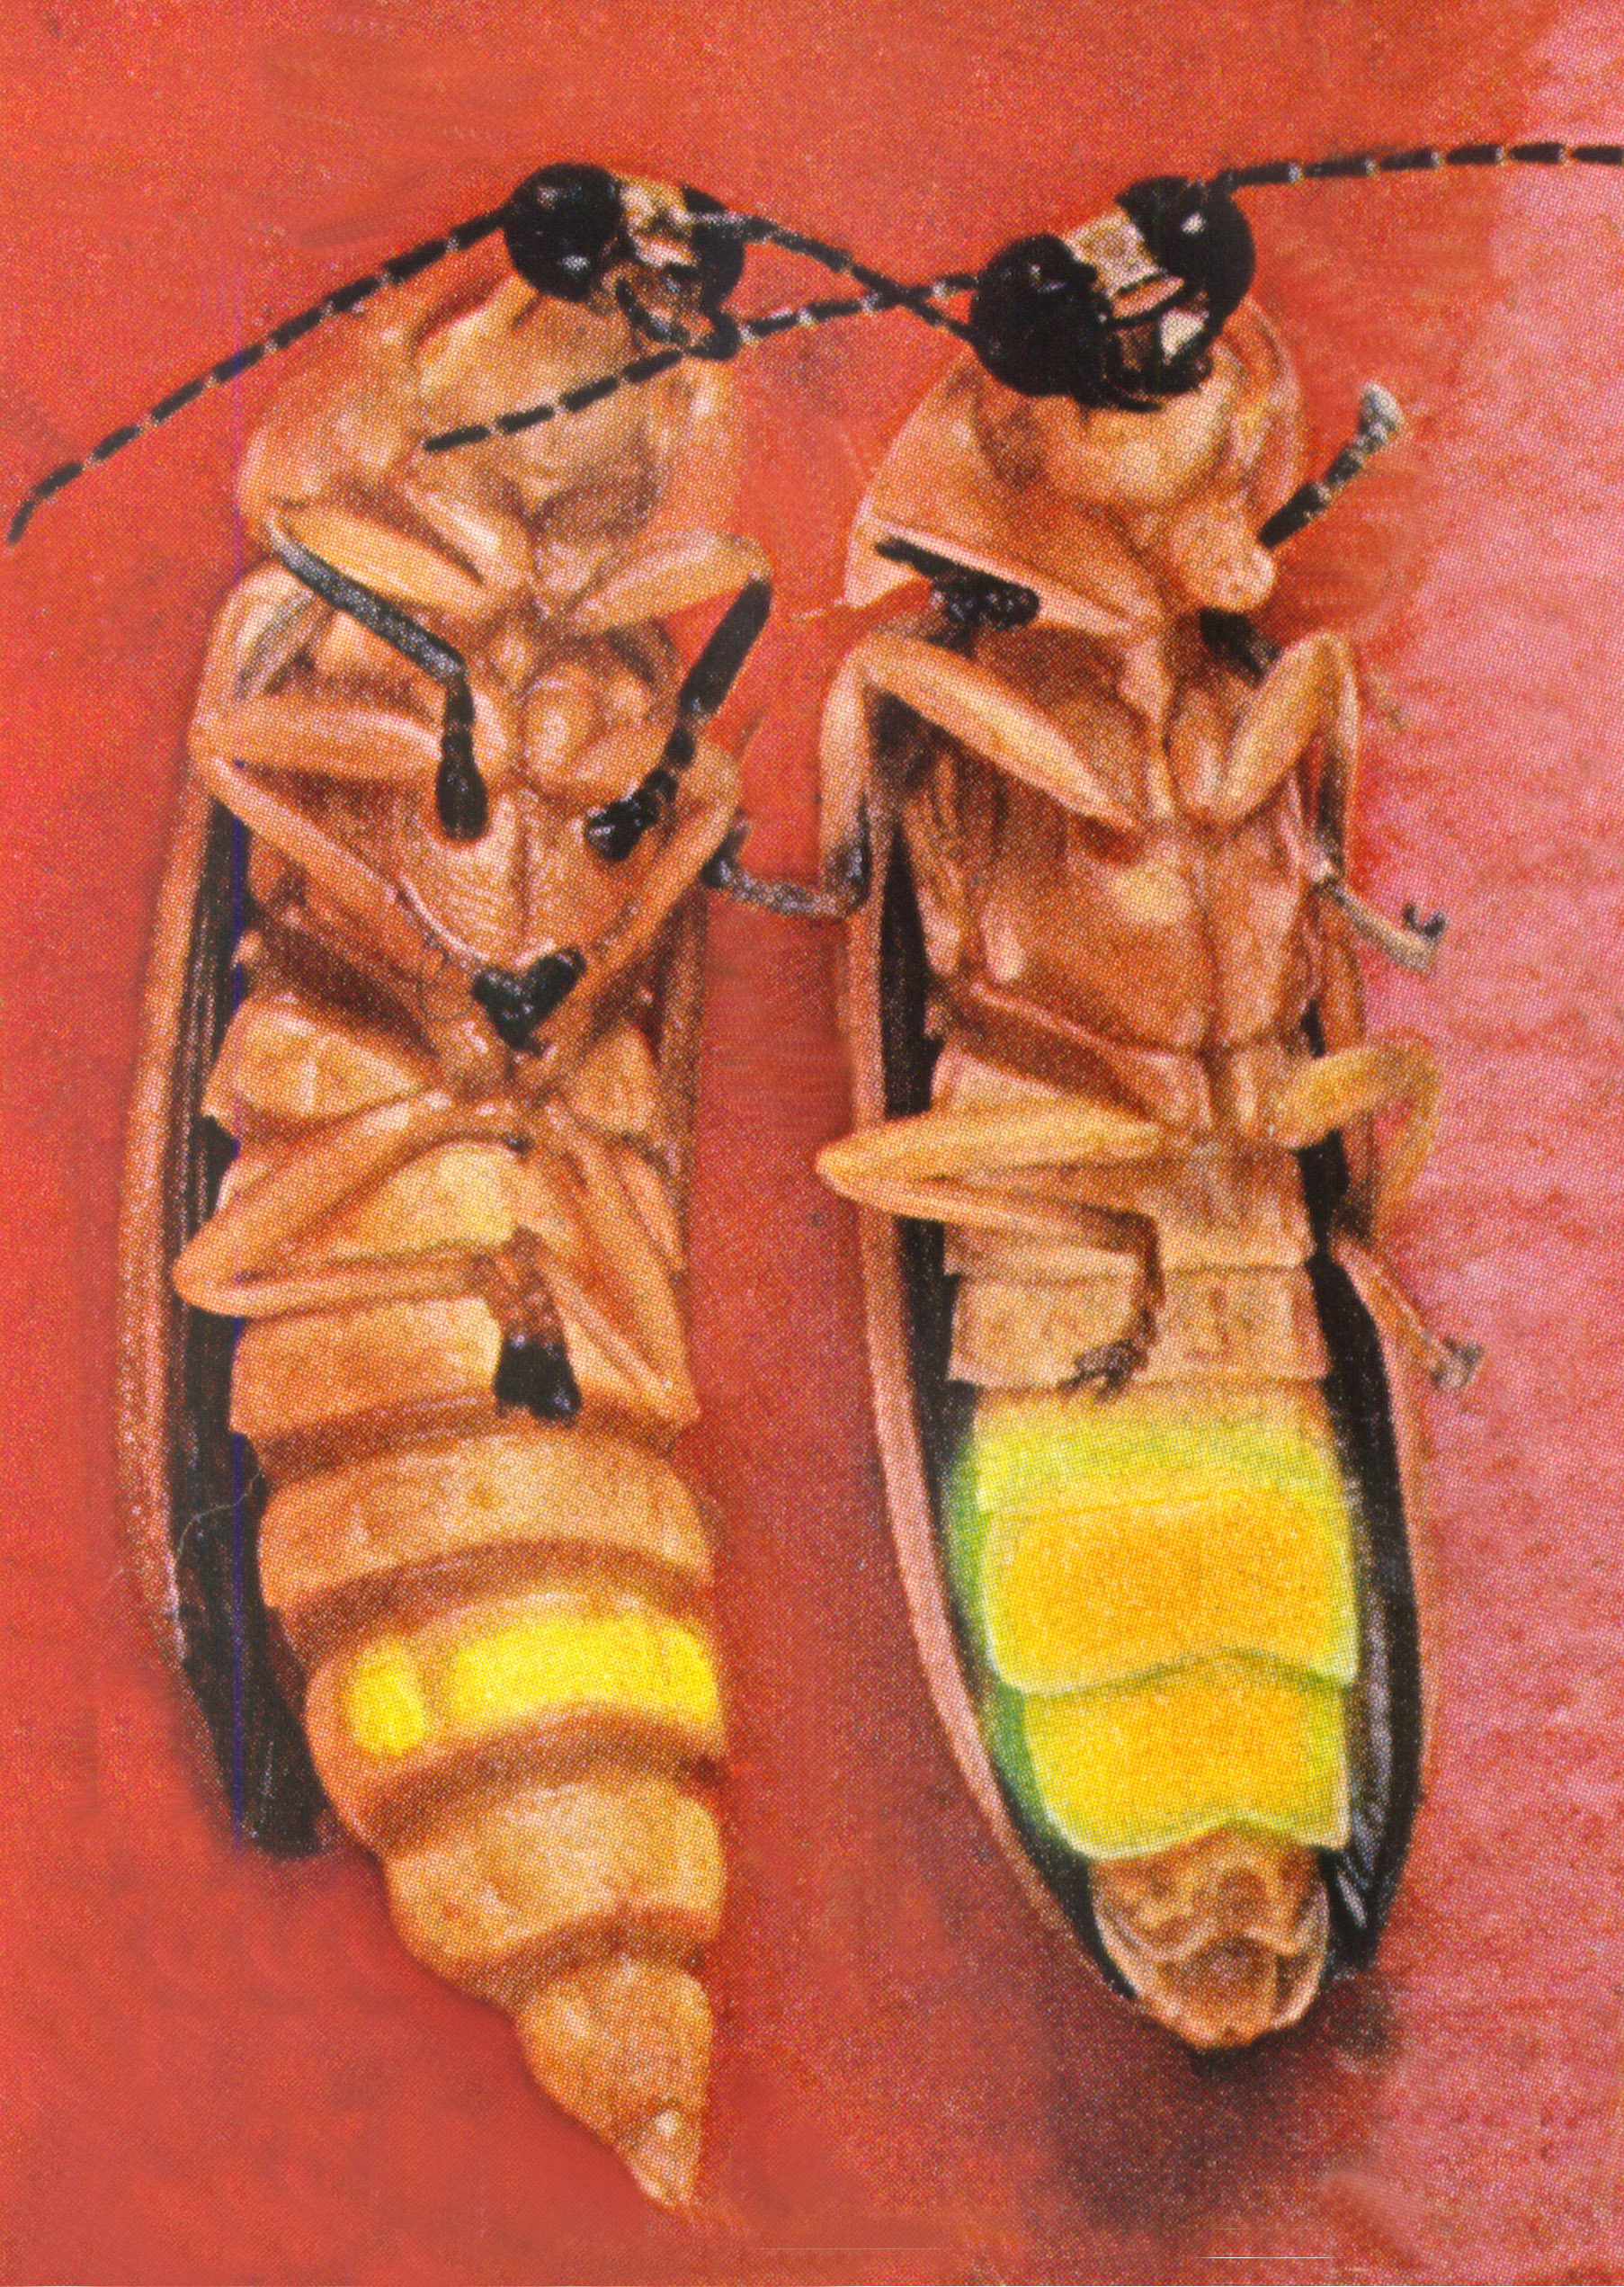
bioluminescence--self-produced light
fireflies
luciferin + enzyme luciferase + oxygen = activated form that releases light
pattern and duration of
flashing is specific for
each species

Slide 6
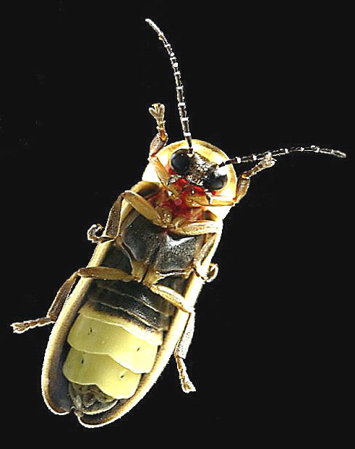
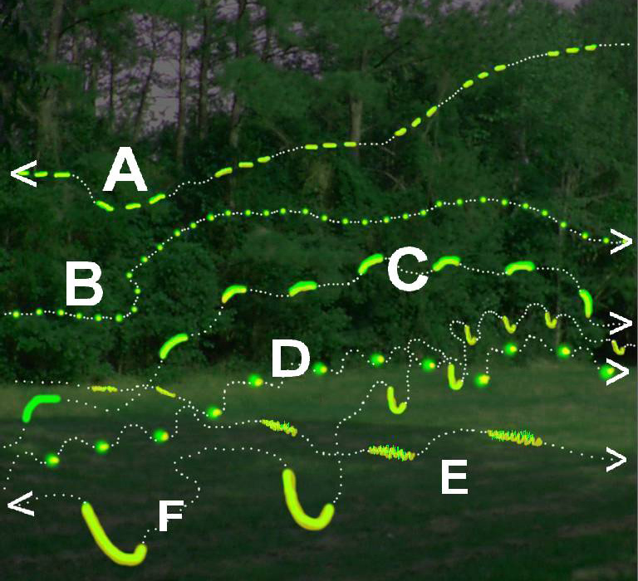

Slide 7
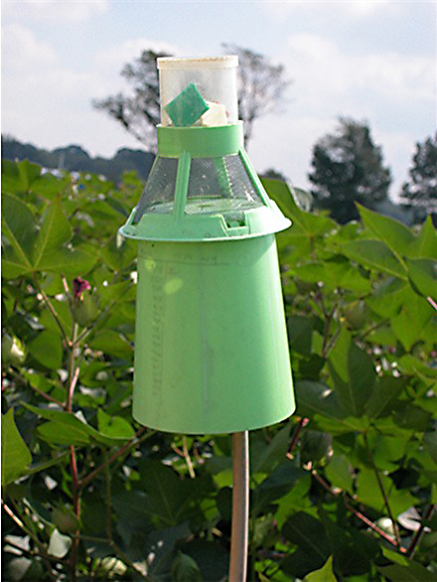
Chemical Communication
pheromone--chemical used to send a message within a species
both the sender and the receiver benefit
pheromones can be identified and artificially produced
can be a weak link to exploit for
insect control
traps to monitor pest population
or kill or disrupt mate-finding
pheromone trap

Slide 8
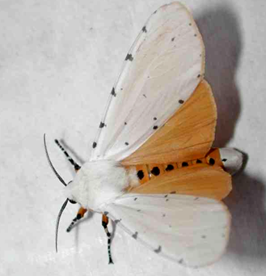
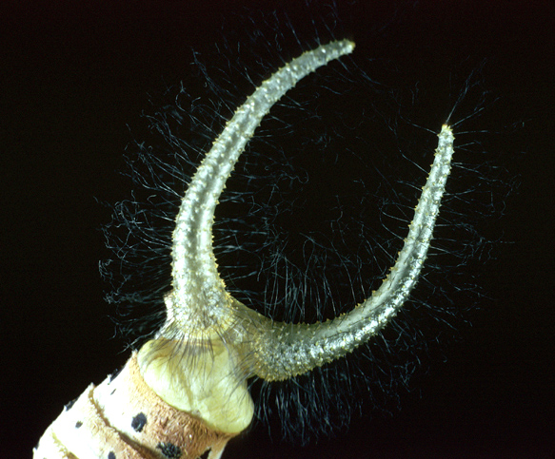
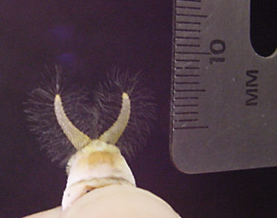
saltmarsh
caterpillar moth
females choose a male
based on gland size and
how much pheromone he produces
male uses host plant chemicals to make
pheromone
without proper chemical from larval
plant food, glands underdeveloped,
males can't attract females
chemical + visual communication

Slide 9
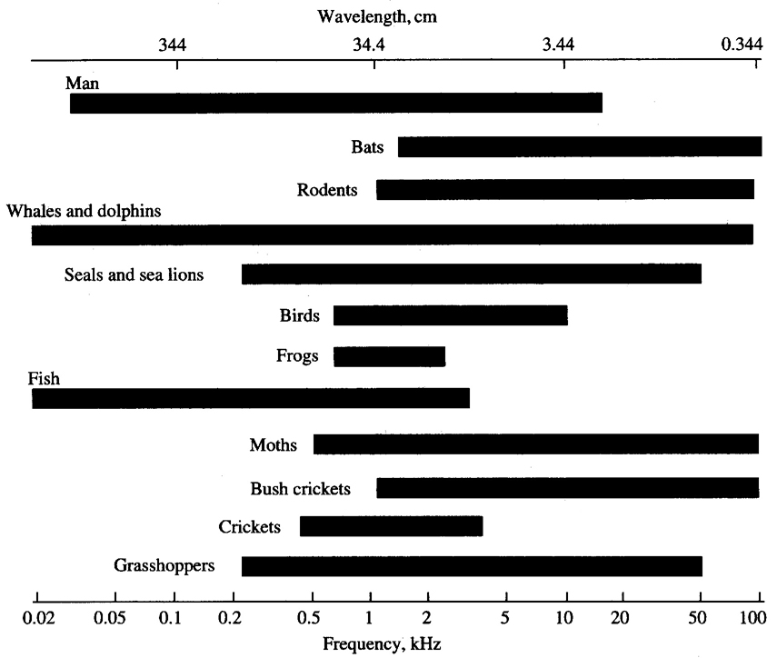
Sound Communication
1. define territory
2. attract a mate
3. courtship and
copulation
Sound range of
5-100,000 Hertz
above 20,000 Hz
is ultrasound
50 hertz
20,000 hertz

Slide 10
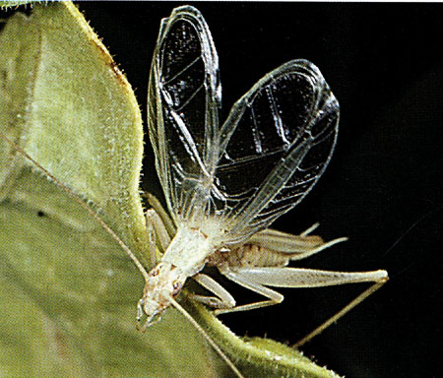
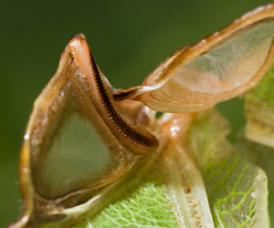
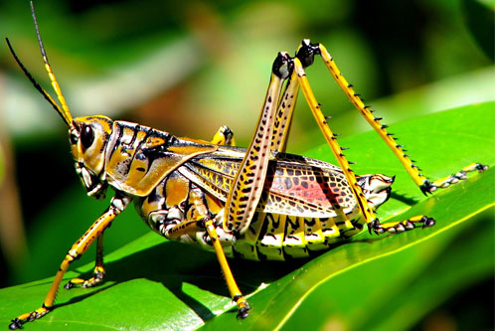
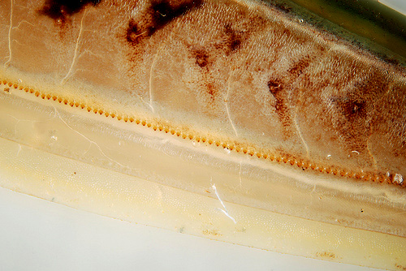

Slide 11
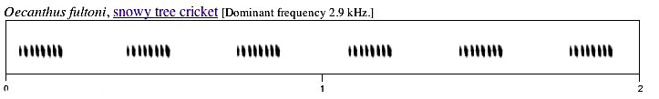
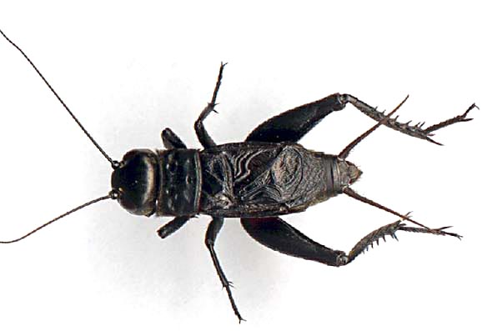
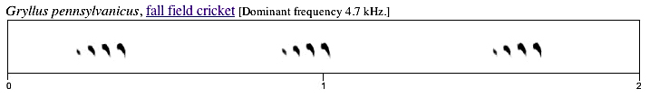
tree cricket
field cricket

Slide 12
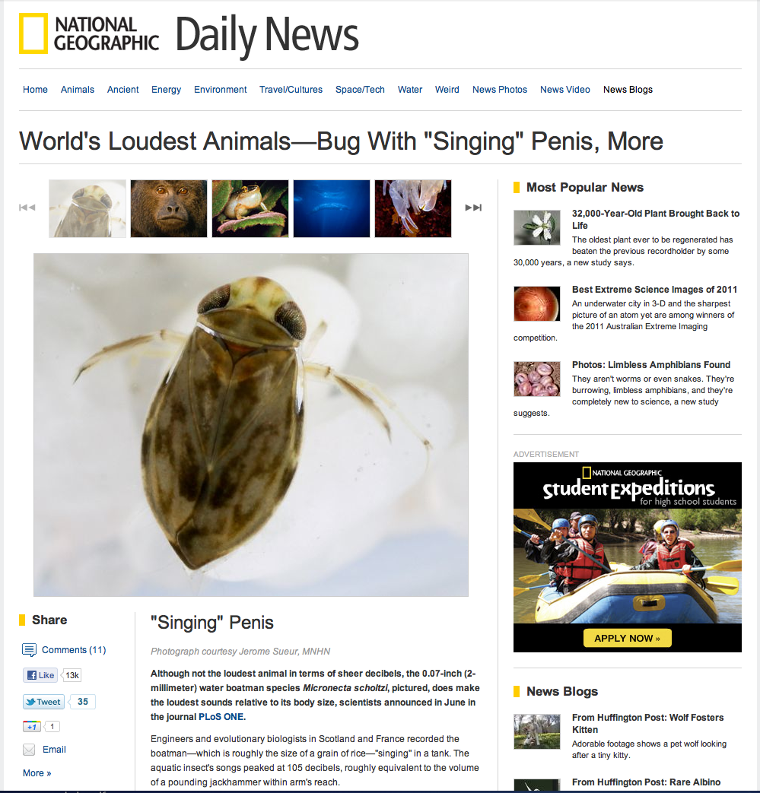
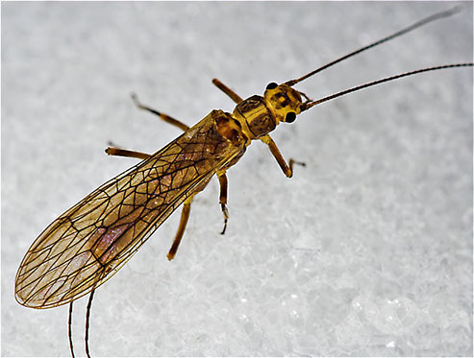
loudest insect relative to
body size 105 decibels
species-specific patterns
male stoneflies “drum” on the
substrate to attract a female

Slide 13

Communication is essential but must overcome barriers
Insects use a variety of ways to communicate, often
related to attraction/courtship/mating
These include visual, chemical, auditory, vibratory.
The environment is full of insects communicating within species and between species. Humans generally are unaware of the vast amount of information being transmitted
because much of that information is on a very small and local scale, or beyond the range of our senses.

